Slide 1
God's Sovereignty, Man's Responsibility
Ludwig
01/05/18

Slide 2
A. God’s Complete Sovereignty
Colossians 1:16-18
¹⁶ For by Him all things were created
that are in heaven and
that are on earth,
visible and invisible,
whether thrones or dominions
or principalities or powers.
All things were created through Him and
for Him.
¹⁷ And He is before all things, and
in Him all things consist.
¹⁸ And He is the head of the body, the church, who is the beginning, the firstborn from the dead, that in all things He may have the preeminence.

Slide 3
Ephesians 4:1-6
¹ I, therefore, the prisoner of the Lord, beseech you to walk worthy of the calling with which you were called,
² with all lowliness and gentleness, with longsuffering, bearing with one another in love,
³ endeavoring to keep the unity of the Spirit in the bond of peace.
⁴ There is one body and one Spirit, just as you were called in one hope of your calling;
⁵ one Lord, one faith, one baptism;
⁶ one God and Father of all, who is above all, and through all, and in you all.

Slide 4
Isaiah 46:10
¹⁰ Declaring the end from the beginning,
And from ancient times things that are not yet done,
Saying, ‘My counsel shall stand,
And I will do all My pleasure,’

Slide 5
Acts 17:24-34
²⁴ God, who made the world and everything in it, since He is Lord of heaven and earth, does not dwell in temples made with hands.
²⁵ Nor is He worshiped with men’s hands, as though He needed anything, since He gives to all life, breath, and all things.
²⁶ And He has made from one blood every nation of men to dwell on all the face of the earth, and has determined their preappointed times and the boundaries of their dwellings

Slide 6
God is the Creator of all things
He is the Lord & Possessor of heaven and earth
God is not contained in any dwelling
God is complete & is in His fullness on His own
God gives life to all people
God sets pre-appointed times
God predetermines where man should live and dwell

Slide 7
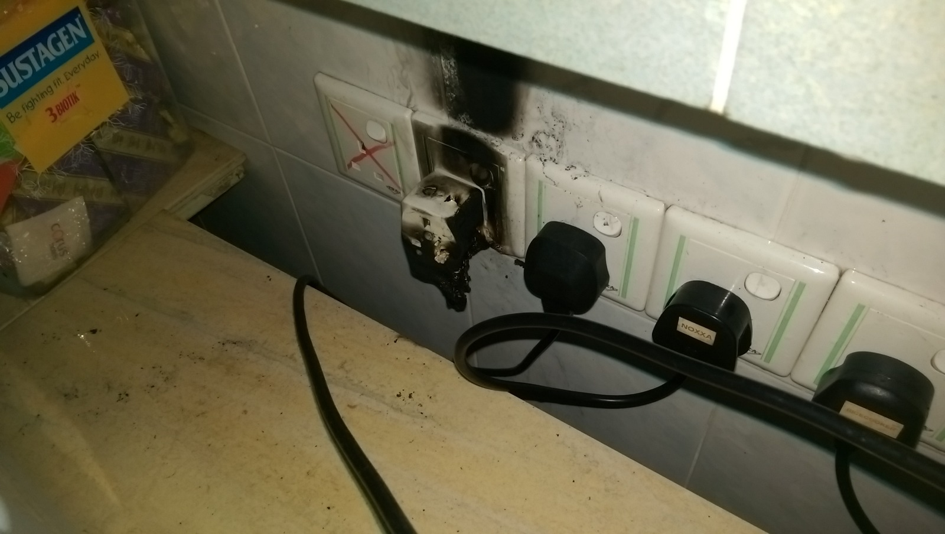

Slide 8
Mark 5:1-20
This man had a legion (3000-6000)
The area was bound and ruled by the enemy
The devil created fear in the region
No one could tame him
Looks like a hopeless and impossible situation

Slide 9
Matthew 19:26
²⁶ But Jesus looked at them and said to them, “With men this is impossible, but with God all things are possible.”

Slide 10
Realise that we can’t do it with the flesh
It’s not by might, nor by Power, but by the Spirit of God

Slide 11
B. Man’s Responsibility
Matthew 25:14-29
We are given according to our ability
We are accountable and responsible with what God has given us
We gain what we use, We lose what we don’t use

Slide 12
Philippians 2:12-14
¹² Therefore, my beloved, as you have always obeyed, not as in my presence only, but now much more in my absence, work out your own salvation with fear and trembling;
¹³ for it is God who works in you both to will and to do for His good pleasure.

